Slide 1

Case study: Online video sharing and social media platform

Slide 2
Business Requirements
Build an online video sharing and social media platform like YouTube.
MVP
Login
Video upload
Video search
Video browse
User Profile

Slide 3

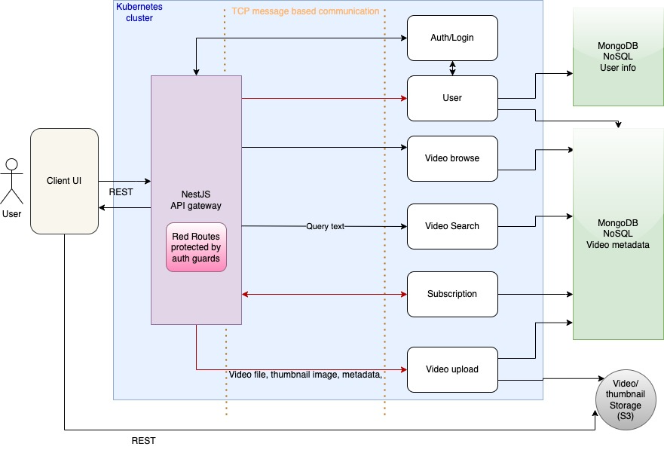
Architecture Diagram

Slide 4
Application components
API Gateway (vid-gateway)
Built using NestJS.
Encapsulates all the microservices and serves as the primary interface for the entire application
All the external HTTP requests pass through it and are then routed to the designated recipient microservice.
It also serves the intercommunication amongst the microservices using the TCP based message communication.
Auth/Login Service
It is a microservice, which allows the user to sign-up, as well as login using the username and password,
It performs the validation of login credentials.
User Service
It allows the UI to fetch basic user profile data from the database.
Once the user is validated, it provides the access token to the client, encoded in JWT token

Slide 5
Application components
Upload Service
It is a microservice to allow user to upload the video file as well as the thumbnail from the UI and save it to the storage (like S3) and save the reference in the MongoDB
Browse Service
It is a microservice to allow user to fetch the thumbnails and metadata of all the videos stored in the database.
Search Service
It allows the user to find the video(s) based on search keywords or filters applied at the UI and return the video metadata and thumbnails
Subscription Service
It allows user to subscribe to a specific user, which in turn allows him/her to get notifies when the subscribed user uploads any new video.

Slide 6
Microservices
Microservices is an architectural style where a large application is broken down into smaller, loosely coupled services that communicate via APIs.
Benefits:
Scalability: Each microservice can be independently scaled.
Flexibility: Enables different teams to independently work on different services.
Resilience: Failure of one service doesn't affect the entire system.

Slide 7
Monorepo Application
NestJS framework has been used in monorepo mode, to create and manage the codebase for multiple microservices in a single version control repository.
Benefits:
Simplified code sharing and reuse.
Easier dependency management.
Streamlined development and testing processes.
Single DockerFile with multi-stage build for each microservice.
Single Jenkins file for easier deployment

Slide 8
Security/ OAuth 2.0
API gateway pattern is used to provide secured external access to each microservice.
OAuth2.0 is used for authorization. Access token is encoded in JWT. JSON Web Tokens (JWT) is an open standard for securely transmitting information between parties as a simplified JSON object.
Protected routes are guarded using Authentication guards based on PassportJS authentication strategies.
How It Works:
User logs in and receives a JWT access token.
Token is included in subsequent API requests for authentication.
Server validates the token and grants access to protected resources.

Slide 9
GraphQL
It was developed by Facebook and provides a more efficient and flexible alternative to traditional REST APIs.
Clients can retrieve all the necessary data with a single request, reducing the number of network requests compared to multiple REST endpoints.
Prevents overfetching & underfetching (common problem with REST).
Preferred where the data structure is complex and diverse, giving client the power to request only the data which is necessary.
Well-suited for real-time applications where data needs to be continuously updated (e.g., chat applications, live feeds).
In practice, some projects may even use a combination of both GraphQL and REST, leveraging the strengths of each based on specific requirements within the application.

Slide 10
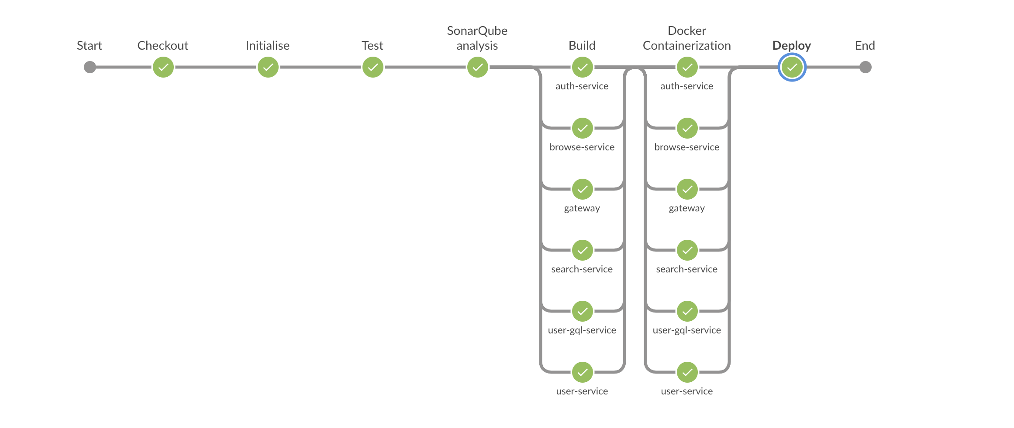
Ci/CD Pipeline

Slide 11
CI/CD Pipeline
Jenkins has been used to implement CI/CD pipeline.
Bitbucket repository has been connected to the pipeline to checkout the code.
SonarQube has been used for quality analysis.
As part of CI/CD pipeline, code quality report is generated, which is visible at the SonarQube server (running in a separate docker container).
Microservices are containerized using docker and deployed to respective Kubernetes PODS.

Slide 12
Deployment
Docker
A single Multi-stage DockerFile is created.
Each stage in the docker file creates the separate image for each service, by running:
docker build -t <image-name> -f Dockerfile --target <stage-name> .
Docker Desktop (for dev purpose)
A single docker-compose.yml is created, which creates a virtual docker network and deploysthe container for each service in it.
Running app & containers can be visualized in Docker Desktop

Slide 13
Deployment
Kubernetes
Minikube tool is used for Local Kubernetes deployment. Similar configuration can be used to deploy it in cloud services such as AWS EKS.
Separate Deployment yaml files have been created for each microservice, which can be applied using kubectl, in order to create and deploy them in their respective PODs.
As PODs in K8s cannot be accessed directly from outside, they are exposed using their respective K8s services.
Separate yaml files have been created from the respective service for each POD, which can again be deployed using kubectl apply.

Slide 14
Scalability
We can scale individual microservices based on demand to handle traffic efficiently.
Benefits of Horizontal Scaling: Improved performance and responsiveness during peak usage periods.

Slide 15
Thank you

